Slide 1
GLP-1 Receptor Agonists for Weight Loss
Group 1: Adele Lopez, Fransheska Serrano, Yarea Wahbeah, Matthew Kurniawan

Slide 2
Background

Slide 3

Background
Obesity is a chronic disease defined by excessive fat deposits that can impair health. It can lead to type 2 diabetes, heart disease, and affect bone health and reproduction.
G-protein coupled reactors (GPCRs) are the most extensive group of membrane proteins and are responsible for regulating many important biological processes. The dysregulation of GPCRs can be used to target various chronic diseases, including diabetes and obesity.
Drugs targeting GPCRs such as GLP-1RA, has been approved for weight management.
Notes:
the expression of GPCRs in subcutaneous adipose tissues from healthy lean, healthy obese and unhealthy obese human subjects as well as in adipocytes from mice fed a normal or high-fat diet was assessed by re-analyzing RNA-sequencing data [24,25]. Our comprehensive analysis revealed several GPCRs with no known role in adipose biology that were highly expressed in adipose tissue and demonstrated significant changes in expression during adipogenesis and/or in diseased human subjects.
GPRC5B has previously been shown to activate obesity-induced inflammatory signaling in adipocytes and Gprc5b-/- mice are protected from diet-induced obesity and insulin resistance
https://www.ncbi.nlm.nih.gov/pmc/articles/PMC9913134
ozempic is bla

Slide 4
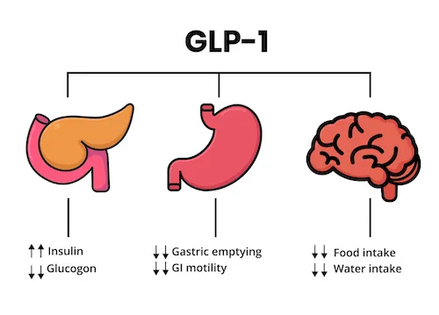
GLP-1
GLP-1 is a peptide hormone secreted by the gut L cells that improve glucose homeostasis and promote weight loss.
Stimulates the secretion of insulin from pancreatic beta cells in response to elevated blood sugar levels. This helps to lower glucose levels after meals
Acts on the brain to regulate appetite and food intake
Due to its beneficial effects on blood sugar control and weight management, synthetic versions of GLP-1, known as GLP-1 receptor agonists, have been developed as medications for the treatment of obesity
Notes:
GLP-1 receptor agonist medications make the stomach empty slower and signal the brain that you are full, reducing cravings. They can also help improve fatty liver.
https://utswmed.org/medblog/obesity-medication-weight-program/
Activity of GLP-1 is glucose-dependent mediated through its receptor at the membrane of pancreatic β cells
This hormone exerts its effect by binding to and activating a B class GPCR, specifically, GLP-1R
GLP-1 receptor agonists mimic a protein that is made naturally in our body when we eat. When used for weight management, these medications curb appetites and slows the rate at which food exits the stomach.

Slide 5
Effect on Homeostasis
GLP-1 is unable to stimulate insulin secretion at low levels of glucose in humans.
GLP-1 binding to its receptor, activates protein Heterotrimeric Gs, which then increases the activity of adenylate cyclase, leading to the formation of cAMP.
Elevated cAMP levels lead to the activation of both protein kinase A (PKA) and the cAMP-regulated guanine nucleotide exchange factor II.
When glucose levels are high, GLP-1 influences ATP-sensitive or voltage-gated potassium and calcium channels. This causes membrane depolarization and the release of calcium ions (Ca2+) from both internal and external storage. The increased Ca2+ levels, along with cAMP, stimulate the release of insulin-containing vesicles.
Notes:
GLp-1 is able to stimulate the secretion of insulin when glucose levels are high by activating pathways which involve cyclic AMP and calcium. However, its effectiveness is reduced when glucose levels are low

Slide 6
Model

Slide 7
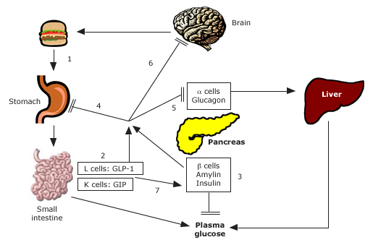
Overall Model
Notes:
In healthy individuals, (1) ingestion of food results in (2) release of gastrointestinal peptides (GLP-1 and GIP) as well as (3) pancreatic beta cell hormones (insulin and amylin). GLP-1 and amylin, in particular, have inhibitory effects on (4) gastric emptying, (5) glucagon release, and (6) appetite. (7) Following the absorption of food, GLP-1 and GIP promote insulin secretion, otherwise known as the incretin effect.

Slide 8
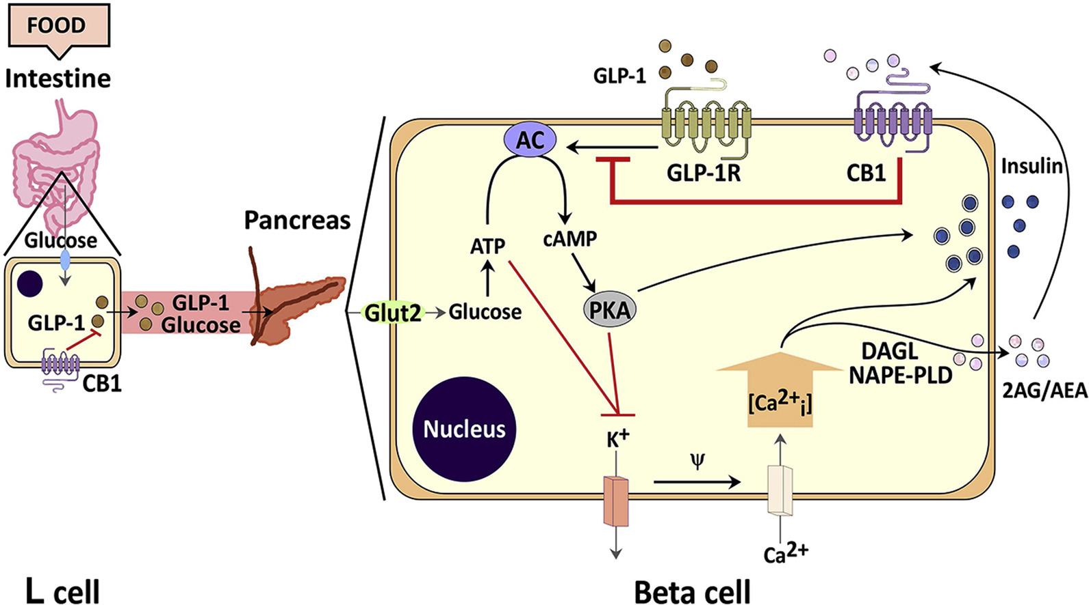
Intracellular Model
Notes:
-GLP1RA work by controlling appetite and glucose levels via CNS
-GLP1 is a naturally occurring hormone in the body, what Ozempic like drugs are is that they are a synthetic form of this hormone that have an increased half life
-

Slide 9
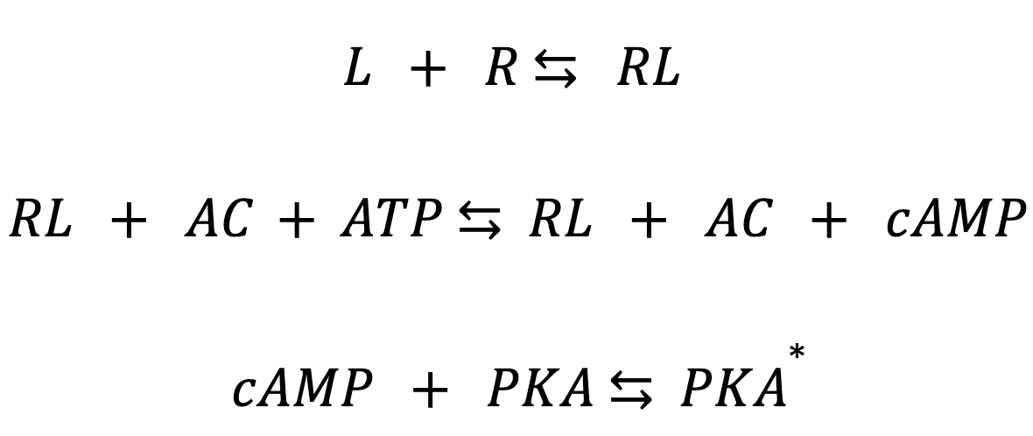
Model
Key:
L: GLP-1 Ligand
R: Receptor found on surface of pancreatic β cells
AC: Adenylyl Cyclase
cAMP: Cyclic AMP
PKA: Protein Kinase A
PKA*: Activated Protein Kinase A

Slide 10
Differential Equations

Slide 11
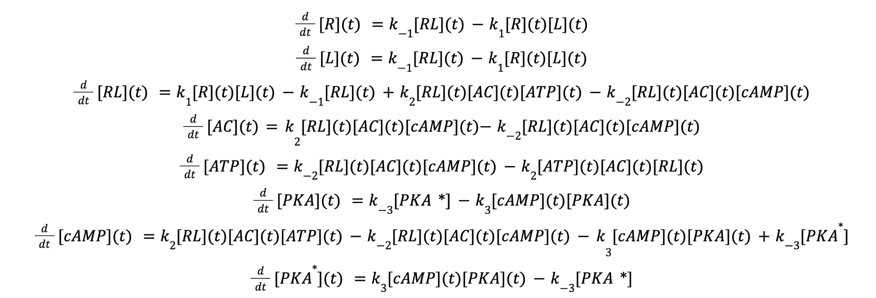
Differential Equations

Slide 12
MATLAB Code

Slide 13
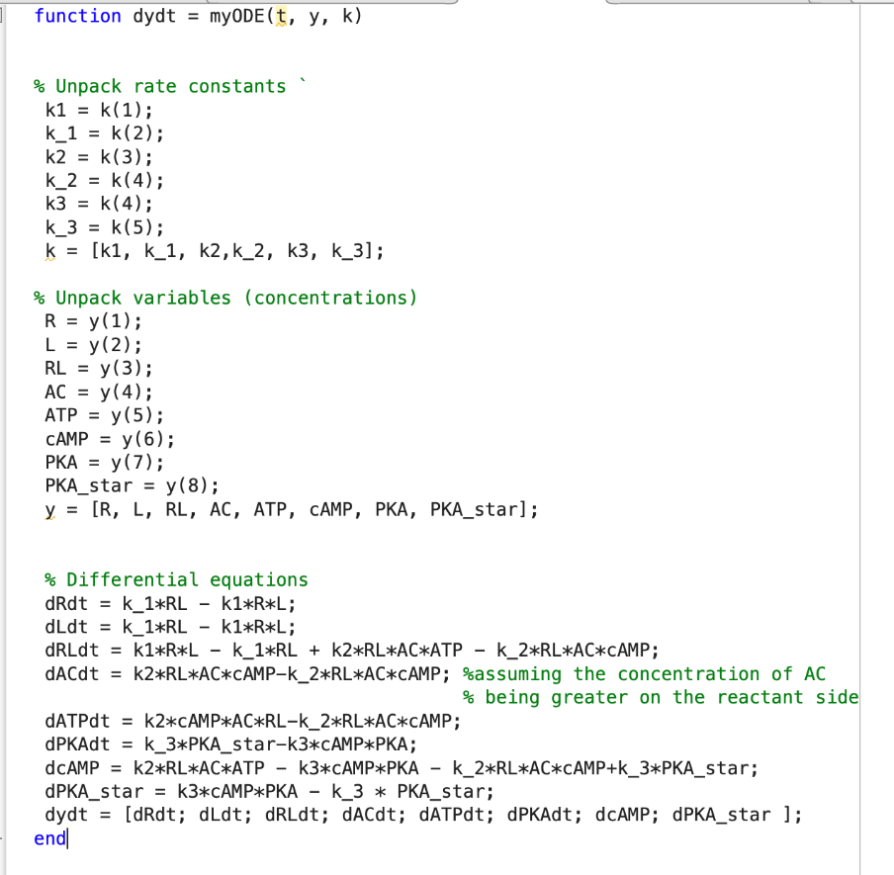
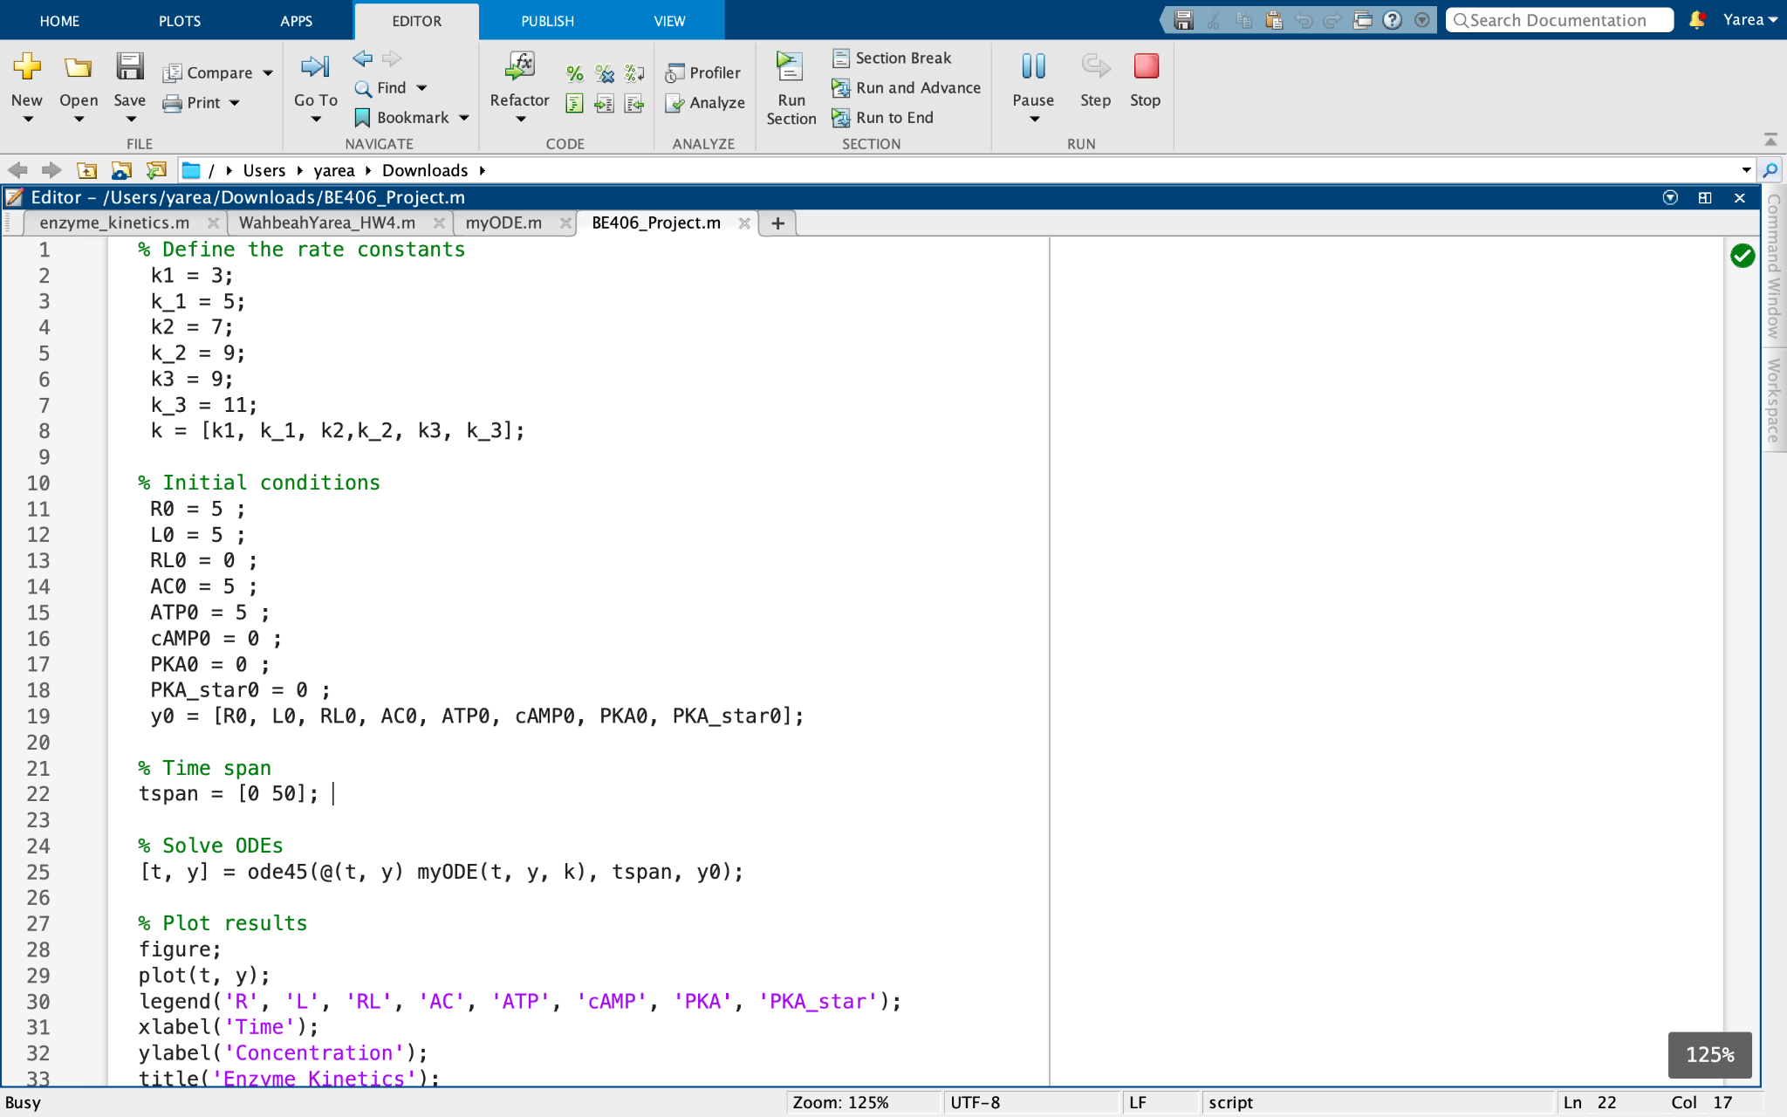
MATLAB Code

Slide 14
Analysis

Slide 15
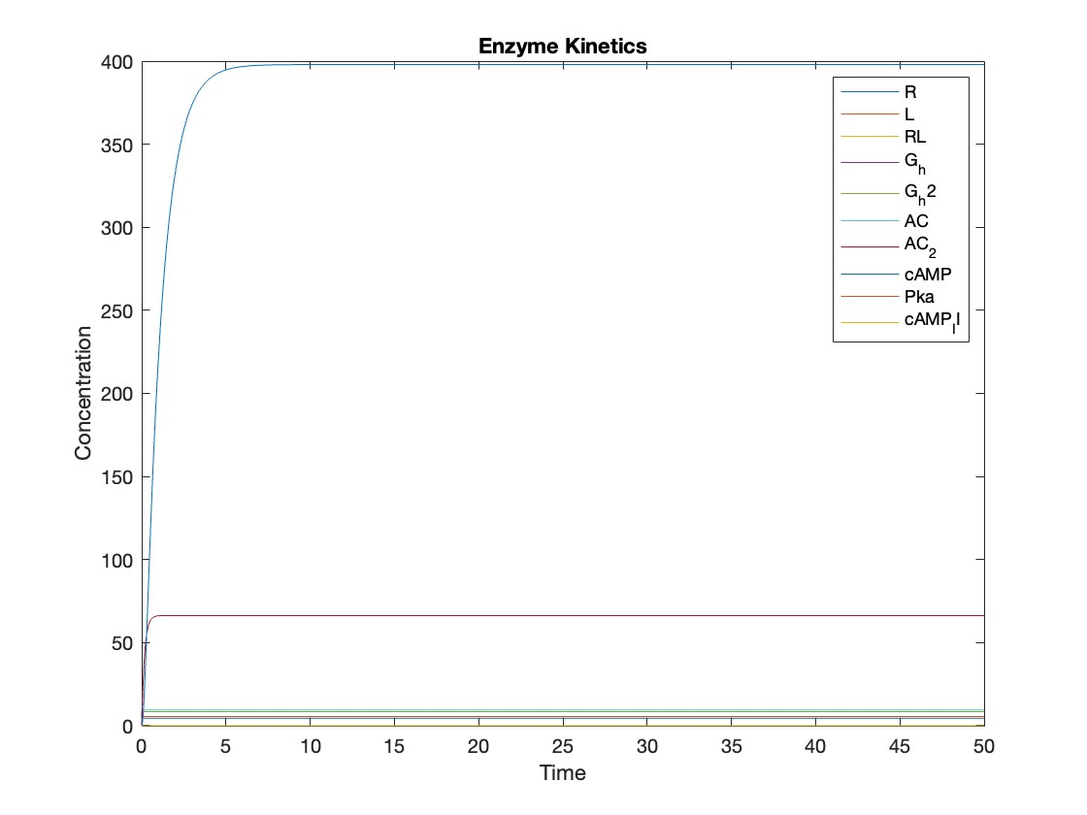
Model Analysis

Slide 16
Conclusion
deorphanization of orphan gpcr to provide novel targets
development of lead compounds that target B2 and F GPCR
polypharmacology to improve drug therapies
integrate and refinement of data to ai to guide virtual and experimental screening of therapeutic agents
Notes:
Future opportunities may arise from: (i) de-orphanization of orphan GPCRs to provide novel targets; (ii) new indication for drug intervention via discovery and/or repurposing efforts; (iii) development of lead compounds targeting classes B2 and F GPCRs to address unmet medical needs; and (iv) validation of polypharmacology may lead to improved drug therapies.
Integration and refinement of massive data by artificial intelligence is a clear direction to guide both virtual and experimental screening of efficacious therapeutic agents with new scaffolds and of novel chemotypes for all classes of GPCRs
https://www.ncbi.nlm.nih.gov/pmc/articles/PMC7790836/
swaiting for the first orally active GPCR-based incretin secretagogue medicine. Nevertheless, hitherto understanding of GPCRs-mediated signalling in the pathophysiology of metabolic disorders justifies the further pursuit of GPCR as a target. While embarking on a drug discovery campaign, there are some limitations and hurdles to consider while developing an oral poly-GPCR-based agonist therapy to leverage intestinal L-cells-derived GLP-1 to treat diabesity.
GPR40, GPR119, TGR5, and GPR55 belong to the class-A GPCR family, which has proven challenging in obtaining high-resolution structures. Limited structural information may hinder the rational design of potent and selective agonists for these receptors.
In addition, selectivity is a crucial goal to aim to. Targeting multiple GPCRs simultaneously increases the risk of non-specific binding and off-target cardiac, hepatic, renal effects and/or β-cell toxicity. Achieving selectivity for each GPCR in the combination therapy is crucial to minimize unwanted side effects and maximize therapeutic efficacy.
Furthermore, finding the right balance and identifying the desired optimal ratio of each GPCR agonist entity in an unimolecular poly-agonist is an intricate task. Specific drug screening tools, like clinical modelling and in-vivo models, need to be developed to study optimal specificities for each GPCR.
Finally, pharmacodynamic and pharmacokinetic considerations are crucial aspects. Each GPCR component and DPP-IV inhibitor moiety present in a single therapy may have distinct pharmacokinetic and pharmacodynamic properties. Achieving the appropriate pharmacokinetic profiles for all components of the poly-GPCR therapy can be challenging, especially considering potential drug-drug interactions. Moreover, distinct receptor expression levels, turnover rates, desensitization mechanisms etc. can affect pharmacodynamics.
https://www.sciencedirect.com/science/article/pii/S0753332224001264

Slide 17
Issues and Future research
class A gpcr family challenge to obtain high resolution structures, limited structural information
Achieve selectivity for each gpcr in combination therapy to minimize side effects and maximize therapeutic efficacy
find right balance and identify desired optimal each gpcr agonist entity develop, drug screening tools to study optimal specificities for each gpcr
pharmacokinetic profiles for all components of poly gpcr therapy
Notes:
GPR40, GPR119, TGR5, and GPR55 belong to the class-A GPCR family, which has proven challenging in obtaining high-resolution structures. Limited structural information may hinder the rational design of potent and selective agonists for these receptors.
In addition, selectivity is a crucial goal to aim to. Targeting multiple GPCRs simultaneously increases the risk of non-specific binding and off-target cardiac, hepatic, renal effects and/or β-cell toxicity. Achieving selectivity for each GPCR in the combination therapy is crucial to minimize unwanted side effects and maximize therapeutic efficacy.
Furthermore, finding the right balance and identifying the desired optimal ratio of each GPCR agonist entity in an unimolecular poly-agonist is an intricate task. Specific drug screening tools, like clinical modelling and in-vivo models, need to be developed to study optimal specificities for each GPCR.
Finally, pharmacodynamic and pharmacokinetic considerations are crucial aspects. Each GPCR component and DPP-IV inhibitor moiety present in a single therapy may have distinct pharmacokinetic and pharmacodynamic properties. Achieving the appropriate pharmacokinetic profiles for all components of the poly-GPCR therapy can be challenging, especially considering potential drug-drug interactions. Moreover, distinct receptor expression levels, turnover rates, desensitization mechanisms etc. can affect pharmacodynamics.
https://www.sciencedirect.com/science/article/pii/S0753332224001264

Slide 18
References
[1] C. D. Graaf et al., “Glucagon-Like Peptide-1 and Its Class B G Protein–Coupled Receptors: A Long March to Therapeutic Successes,” Pharmacol Rev, vol. 68, no. 4, pp. 954–1013, Oct. 2016, doi: 10.1124/pr.115.011395.
[2] Role of GLP-1 Receptor Agonists for Weight Loss, (May 05, 2022). Accessed: May 08, 2024. [Online Video]. Available: https://www.youtube.com/watch?v=P6gt4A_3Whs
[3] “Anti-obesity drugs are closing the gap between dieting and bariatric surgery | Diet and Nutrition | Prevention | UT Southwestern Medical Center.” Accessed: May 08, 2024. [Online]. Available: http://utswmed.org/medblog/obesity-medication-weight-program/
[4] N. K. Smith, T. A. Hackett, A. Galli, and C. R. Flynn, “GLP-1: Molecular mechanisms and outcomes of a complex signaling system,” Neurochemistry International, vol. 128, pp. 94–105, Sep. 2019, doi: 10.1016/j.neuint.2019.04.010.
[5] A. Pocai, “G protein-coupled receptors and obesity,” Front. Endocrinol., vol. 14, p. 1301017, Dec. 2023, doi: 10.3389/fendo.2023.1301017.
Notes:
https://utswmed.org/medblog/obesity-medication-weight-program/

Slide 19
Questions?

